Slide 1


NBA PLAYER SALARIES
Jared Dukes, Anastasia Livaditis, Vince Hrabe, Cooper Hird, and Anna Pigulko
This Photo by Unknown Author is licensed under CC BY-NC-ND

Slide 2
MAIN QUESTIONS/HYPOTHESIS
Which factors correlate with player salary?
Which players are undervalued, and which are overvalued?
Hypothesis: Heavily correlated stats will be:
True Shooting Percentage (TS%)
Win Shares (WS)
Games Started (GS)
Minutes Played (MP)
Three-Point Shots Attempted (3PS)
Free Throws Attempted (FTA)
Games Played (G).
Notes:
Our goal: To identify which players are valued properly, and which are under/overvalued. By doing so, we can pinpoint hidden value in the NBA player market.

Slide 3
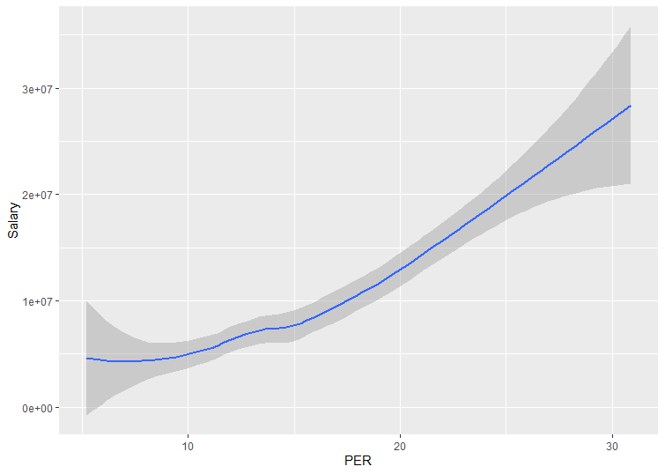
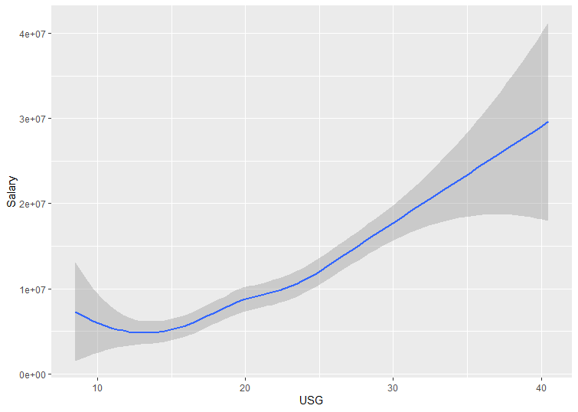
Note: Players with under 300 minutes played were filtered out.
Notes:
-These are two statistics (PER and Usage) that are generally considered to be heavily correlated with player value - a claim that is borne out in the dataset.
-Note: the vast majority of data points lie near the center, as both of these operate on a somewhat normal distribution with a clear central average (15 for PER, 20 for USG)

Slide 4
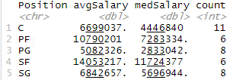
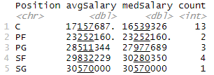
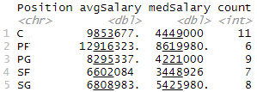
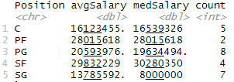
INSIGHTS
Average PER | Between 14 & 16
Elite PER | Above 22
Average USG | Between 19% & 21%
Elite USG | Above 28%
Average PER
Elite PER
Average USG
Elite USG
Notes:
-Here we set a baseline for salary. PER and USG are two numbers heavily correlated to a player’s value - here we break down how much average and elite players are making, using these two statistics.
-Average PER: 14<x<16
-Average USG: 19<x<21
-Elite PER: >22
-Elite USG: >28
-Also, note the discrepancy in average vs. median salary amongst the “Average” stats, while “Elite” stats are pretty balanced. This implies a clear skew towards lower salaries for “Average” players, with a few strong outliers making a ton of money that inflates the average.
-The most clear case of this is with PG’s - when we broke down all players at each position, we noticed that the median salary for PG was 5th out of 5 positions, while the average salary was 3rd. This implies significant outliers, which we will identify at a later point.

Slide 5
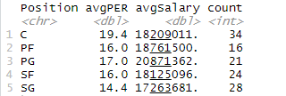
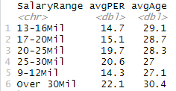
INSIGHTS
Note: these sets were filtered to only include players making more than $10 million.
Notes:
-Filtering out lesser paid players allows us to avoid many of the pitfalls associated with lower paid players - mainly that young players are often not fairly compensated due to “rookie scale contracts” that govern the amount they make on they make on their first deal.
-Centers clearly provide the most value in this range, despite having the largest number of players; Shooting Guards provide on average the least amount of value, indicating either that there are very few well-paid SG’s that are providing immense value, or there are a signficiant number of overpaid SG’s not providing nearly enough value.
-We also see that there is very little difference in performance between the 9-12, 13-16, and 17-20 mil salary ranges.

Slide 6
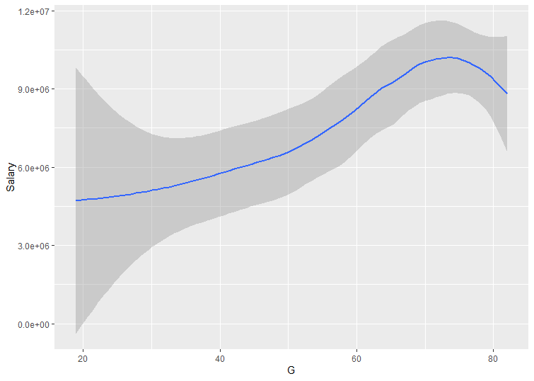
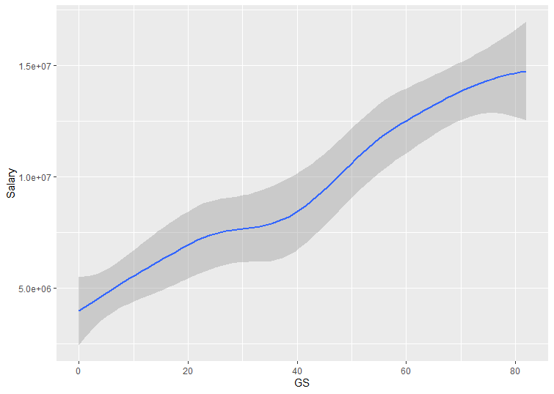
Games vs Games Started
Notes:
-Note that while Games Played is clearly correlated to salary, we can use Games Started as a much more heavily correlated statistic that serves the same purpose. It is interesting to see that Games Started is quite linear, given it has no reason to be so (there is no normal distribution for Games Started)

Slide 7
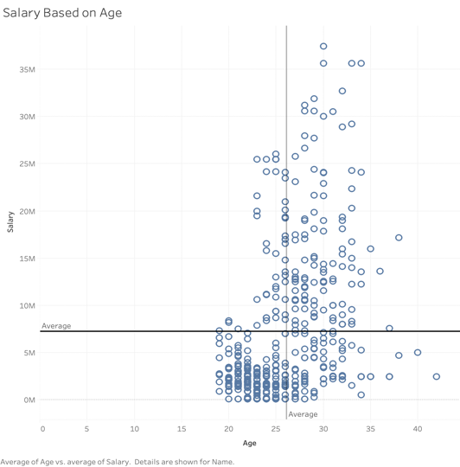
INSIGHTS (CONT.)

Slide 8
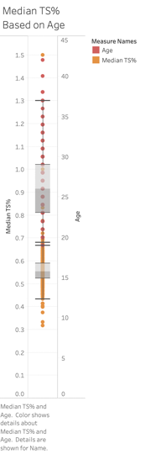
INSIGHTS (CONT.)

Slide 9
NOTES
Center is the highest paid position both in average and median
Point guard is last in median salary, but distinctly third when it comes to average, indicating outliers in this position
67% of players making over $10m next year are between the ages of 25 and 30 (83 out of 123)
Portion of players making over $10m at each position:
PG: 27.1%
SG: 31.4%
SF: 26.2%
PF: 27.1%
C: 42.5%
Portion of players making over $10m at each age range:
22-24: 11.9%
25-27: 38.8%
28-30: 57.7%
31-33: 47.85%
34-36: 54.5%
Over 37: 14.3%

Slide 10
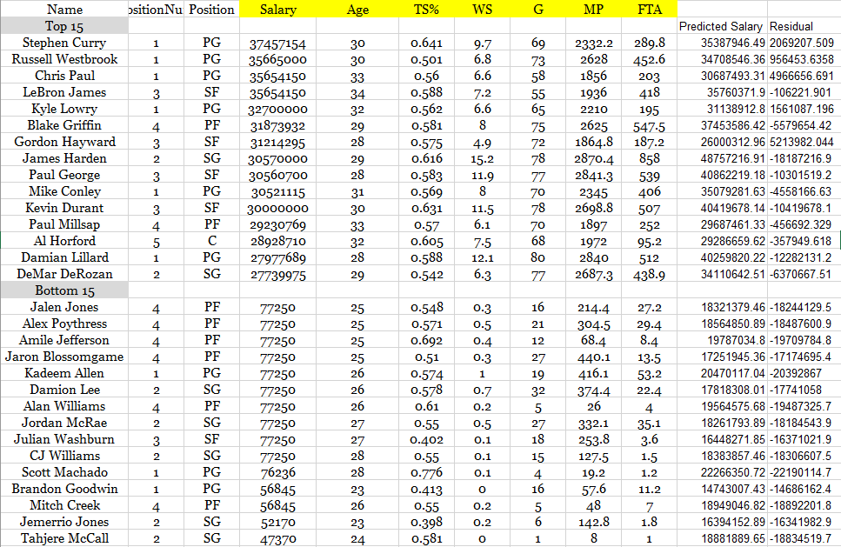
REGRESSION
According to our regression, 439 players performed above their salary while only 9 players performed below their salary.
Notes:
-As I mentioned before, we noticed a huge difference in the average and median salary for PG’s - this is clearly borne out in our Top 15, where a ridiculous 6 out of 15 players are PG’s. This is double what we would expect if it was normally distributed.
-Worth noting that most players in this range are considered slightly overvalued by our model, but this can mostly be explained away by other factors that a superstar brings to a team that cannot be captured statistically.
-An outlier to the above point is James Harden. He has a predicted salary of $48million, a good $18mil above what he is actually paid and $8mil more than any other player was predicted to make. Looking at his key stats (TS, WS, MP, and FA) all bear this out - he is tops or near the tops in all of these categories.

Slide 11
Conclusion
Where can we find value within the NBA player market?
Focus on youth
Avoid paying contracts in the $13-$20 million range
Be more willing to spend on players that will start on your team rather than bench players - even if it is not a permanent starting role
Avoid paying big contracts to SG’s, unless they are clearly elite
The average & median of elite C’s is under $20 million
Notes:
-Focus on youth: As we mentioned earlier, rookie-scale contracts and other CBA rules artificially deflate the value of young players on their first contract; the best deals in the NBA are almost always young stars on rookie contracts.
-Avoid $13-20 contracts: As we noted earlier, there is virtually no discrepancy between performance of guys in the $10-12mil range and both $13-16mil and $17-20mil
-Spend more on starters: As we noted in the Games and Games Started vs Salary graphs, there is a much stronger (and linear) correlation btwn starting games than simply playing. This means finding a guy who starts 30 games is FAR more valuable than a player who simply plays 30 games.
-Avoid big SG contracts: We saw in players paid over $10mil that SG was, on average, providing by far the least amount of value
-Elite C’s: Given the avg/median is under $20mil, teams should be looking to pay elite centers more like $15-18 million, as opposed to paying a max contract (anywhere from $27-$35 mil depending on age). There are simply more elite centers on the market (getting paid less money, too) than at any other position.

